Slide 1
TEAM 4 Capgemini MIPL, Chennai 10th August 2018

Slide 2
Java-FLP project – CapStore
(E-commerce - application)

Slide 3
TEAM MEMBERS
SUSHMITHA S.H (TEAM LEAD)
SARATH NISTALA
VIKAS KUMAR ROY
YAMINI AMBATI

Slide 4

MODULE 19 – PRODUCTS IMAGES
TABLES PRODUCT IMAGES IS DEPENDANT ON:
Inventory. Slideshow view for the products selected.
Images can be zoomed and will be displayed in proper slideshow.
Notes:
O Logo de espadas deve ter mais espaço das pontas abaixo. Sugerir outros tipos de imagens/ telefone, fones.

Slide 5
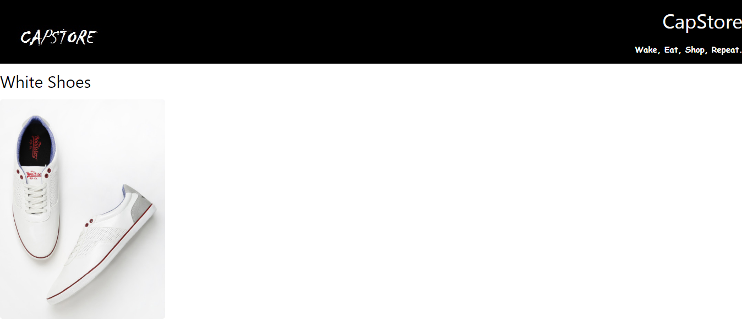
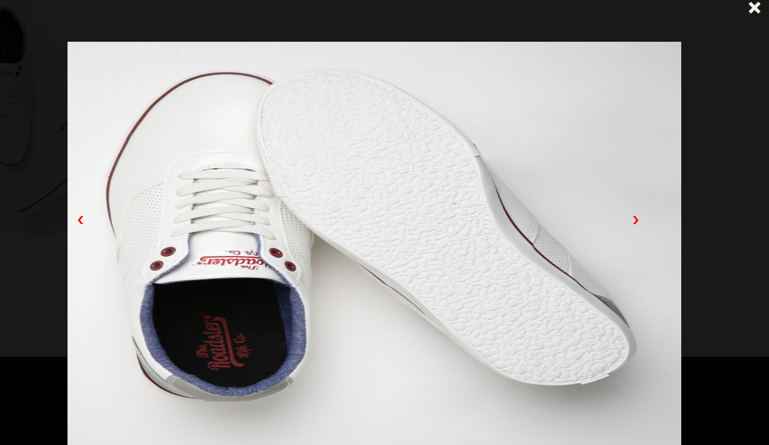
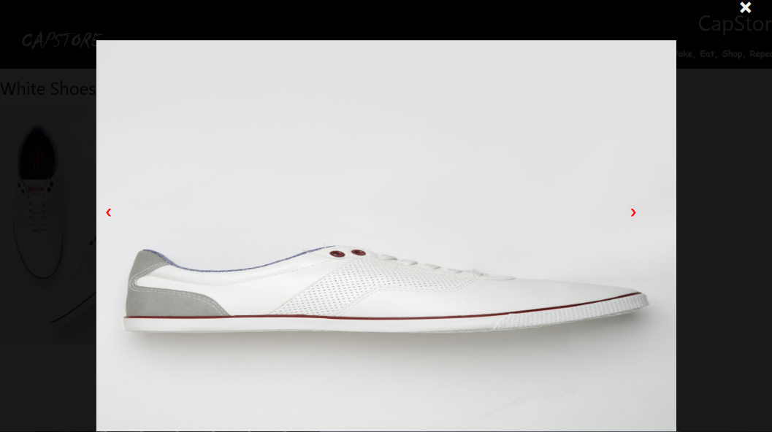
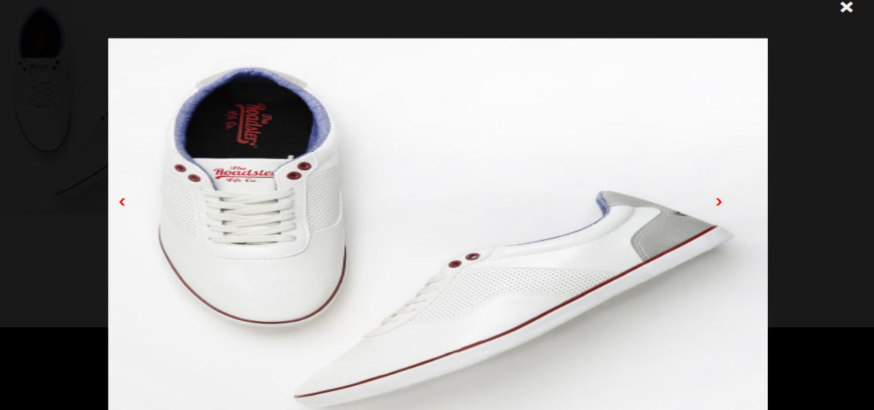

Slide 6
Basic function used:
Hover: Bring the block for image.
On click: click on the image will to show the multiple images in the block.
Display: block or none depend on the click of arrow.

